Slide 1

Vue JS 102
SPA Time!

Slide 2

SPA Single Page Application what we are really here for!

Slide 3
Single Page Applications
Using SPA there is no need to refresh the page every time we make a request to the server
Vue Router helps us create SPA

Slide 4
Module 1 - Advanced Components
Dynamics Catching and ‘Not Reloading’ a component when you go back
Async Component
Only loading a component when you ask for it. View This Later in the SPA

Slide 5
Dynamics
Keeping Alive ‘state’ when you come back
A → AA
B
A
AA?

Slide 6
Module 2 - Prop (Properties)
Dynamic Props Using props but binding the input so that you can pass variables from grandparent -> parent -> child
Props validation added a Type so you don’t get passes nonsense

Slide 7
Module 3 - Mixins (Mix In)
Takes 1 components functions and mix it into another one
Great for apply a function across many types of instances

Slide 8
Arjay To Take Over

Slide 9

Module 4 – Vuex
Centre State Management
“How many drinks did we order?”

Slide 10
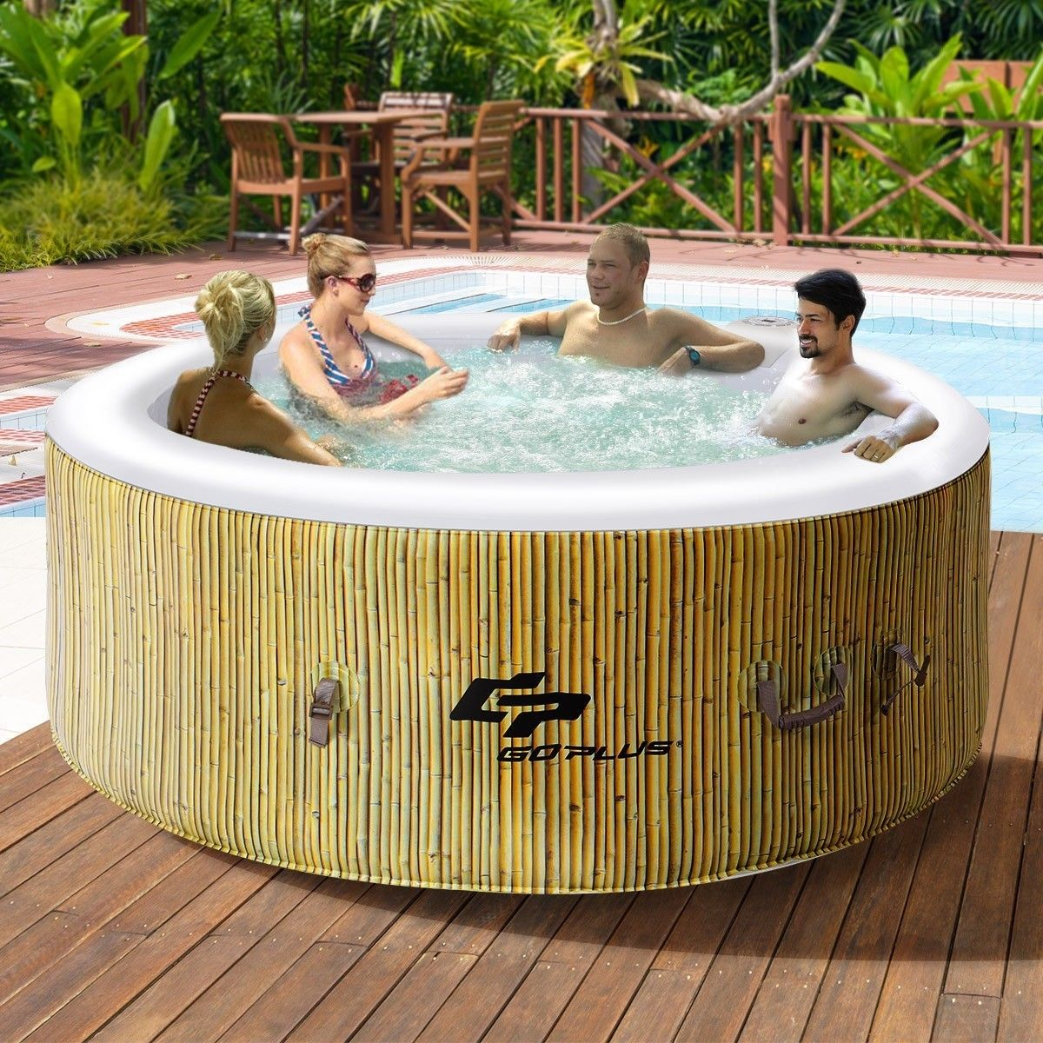
Module 5
Vue Cli and Router

Slide 11
Single Page Applications
Using SPA there is no need to refresh the page every time we make a request to the server
Vue Router helps us create SPA

Slide 12
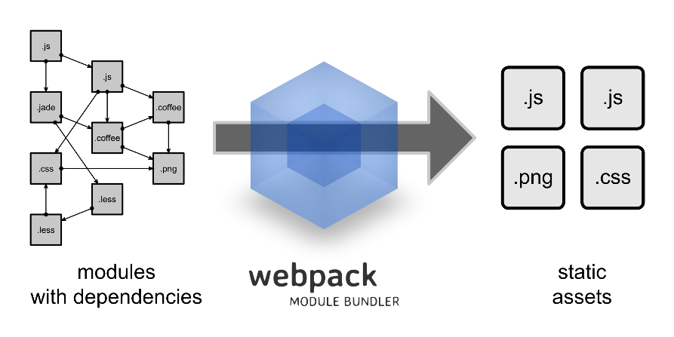
Vue Cli
Vue provides an official CLI for quickly scaffolding ambitious Single Page Applications
Webpack!
Vue Cli is a full system for rapid Vue.js development platform. It allows you to create Vue App can also be deployed on the server
Vue Cli is based on node.js

Slide 13

Ex: Vue App
Code Up Your Application

Slide 14
Install Vue CLI
To install Vue CLI, type the following command to your Windows CMD Prompt or Mac Terminal
npm install -g vue-cli

Slide 15
Installing Node JS
Download and Install Node JS https://nodejs.org/en/download/
To test if Node JS was installed successfully type the following commands on your Windows CMD Prompt / Mac Terminal
node -v
To test if Node Package Manager (NPM) was installed successfully, type
npm -v

Slide 16
Create Vue Project
To create Vue project, type the following command to your Windows CMD Prompt or Mac Terminal:
vue init webpack myapp
cd myapp
npm run dev

Slide 17

Vue App
View on the browser http://localhost:8080/

Slide 18
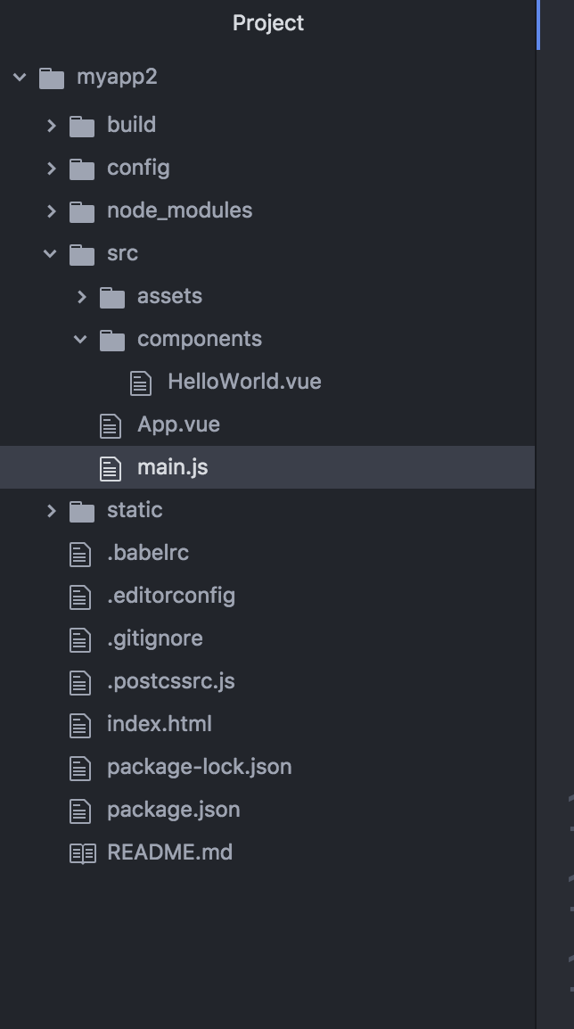
Vue App Structure
The main.js will call the main component App.vue
App.vue component consist of the subcomponents
Each component has template, script and style

Slide 19
Next Level
Build A Coffee App

Slide 20
Secret Level – Build A Registration App
Lionel wants a coffee break app. - For So Tien to buy drinks for everyone in Class.
Features – Junior Dev
People can put [‘name’,’drink’]
Some people change their mind and cancel
some people not allowed (“LIO” in their name)
We can see entire list
More – Pro Dev
People can put amount of money
List will show total
Tech Lead
Stored to localstorage
There’s a filter on the index page for easy searching of some ones order
Can generate a ‘detail’ view of 1 person that look like a recipet
User can put special requirements like ‘less sugar’

Slide 21
“Jeff Dean” Level
Jeff Dean
Build the entire thing to firebase
Auth login with 2 levels of user, (Admin (So Tien), User)
Unit test it
Add a css framework to make it look nice
Have it ready as a PWA
Have it as a hybrid app
Put maps so we can see when were is So Tien
Put status, OPEN, OTW, Purchase
Put algorithm for Estimated Time of Arrival using Triangulation

